Slide 1


A Framework for Improving Data Integration with Linked Data
Ahmad Assaf †
Supervised by:
Aline Senart† and Raphaël Troncy‡
†SAP Research, SAP Research France SAS
‡EURECOM, Sophia Antipolis - France
April11, 2013
Public

Slide 2
Background
M.Sc. Advanced Software Engineering – University of St. Andrews (UK)
Research interests: Collective Intelligence, Data Mining & Integration, Semantic Web
Technical Background: Web Development technologies
RUBIX
remix
Panorama
BI
RTI
Internship Oct 11- April 12
PhD Start May 12
RUBIX: Two-men team (main contributor)
remix: Collaboration between BI teams in Sophia and Dresden (UI\UX)

Slide 3






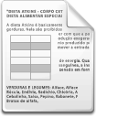




Motivation Linking External Data
Decision Making Process
Enterprise Data
Social Media Feeds
Business Intelligence Analysis
Sensor Data
Governmental Data
ERP - -
PRM
CRM
“ In today’s multi-screen world we need to be able to get relevant content to the customer, at the right time in their format and language of choice”*
*John Walker, NXP Blog http://blog.nxp.com/is-linked-data-the-future-of-data-integration-in-the-enterprise/
Notes:
Companies have traditionally performed business analysis based on transactional data stored in legacy relational databases. The enterprise data available for decision makers was typically relationship management or enterprise resource planning data [2]. However social media feeds, weblogs, sensor data, or data published by governments or international organizations are nowadays becoming increasingly available [3].
Life is no longer as simple as making PDF documents, we need to feed consistent information to all our multi-channel publications (web/mobile/print) and those of our partners “

Slide 4
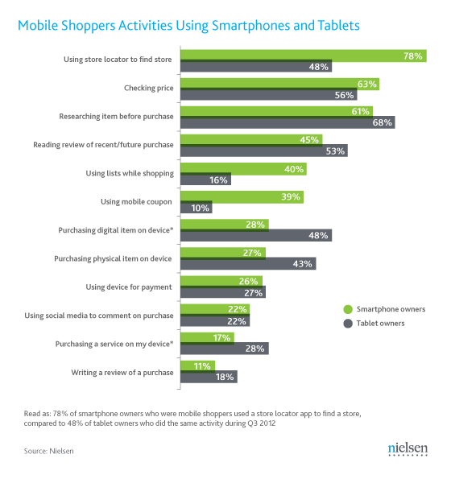
Motivation Linking External Data
“Life is no longer as simple as making PDF documents, we need to feed consistent information to all our multi-channel publications (web/mobile/print) and those of our partners “ **
*http://blog.nielsen.com/nielsenwire/consumer/mobile-devices-empower-todays-shoppers-in-store-and-online/
* http://blog.nielsen.com/nielsenwire/consumer/mobile-devices-empower-todays-shoppers-in-store-and-online/
** John Walker, NXP Blog http://blog.nxp.com/is-linked-data-the-future-of-data-integration-in-the-enterprise/
Notes:
Companies have traditionally performed business analysis based on transactional data stored in legacy relational databases. The enterprise data available for decision makers was typically relationship management or enterprise resource planning data [2]. However social media feeds, weblogs, sensor data, or data published by governments or international organizations are nowadays becoming increasingly available [3].
Life is no longer as simple as making PDF documents, we need to feed consistent information to all our multi-channel publications (web/mobile/print) and those of our partners “

Slide 5
Research Direction
A Framework for Improving Data Integration with Linked Data
Mining
External Catalogue
Integration
Refining
Exploration
Matching
Analysis
Mapping
NER, Pattern matching … etc.
Shared Data source representation
Semantic model and mapping mechanisms
RUBIX V1
Data Quality Framework
RUBIX V2
DCAT Crawler
Yìngshè (Graph Mapper)
Notes:
Public data sets containing billions of data items
Companies are looking to integrate external data with their traditional enterprise data to improve business intelligence analysis

Slide 6
RUBIX – Problem Definition
Distributed sources with heterogeneous data formats and terminologies
Complex data models
Different storage models
Noisiness (duplications, inconsistencies)
→ Need to find mappings between these internal and external complex data structures (schema matching)
Notes:
Model/representation heterogeneity → differences in model (database, ontology) or their representation (relational, RDF . )

Slide 7
RUBIX - Proposal
Goal: Allow business users to semi-automatically combine potentially noisy data residing in heterogeneous silos
Proposal
Implementation
Provide a novel framework enabling schema matching of internal and external sources
Develop several matching algorithms to increase accuracy
Leverage Linked Data to enrich the cells
Compare schemas on several bases:
Column global type and name
Cells` rich types retrieved from Linked Data
Open Refine: A tool designed to process, clean and enrich large amounts of data with existing knowledge bases
Auto Mapping Core: A tool designed by SAP Research, enabling the developer to combine several matching algorithms
Freebase: An open repository of structured data
Notes:
Google Refine targets one data set at a time (no possibility for data sets mash-up)
Google Refine already supports reconciliation with Freebase but requires confirmation from the user.

Slide 8
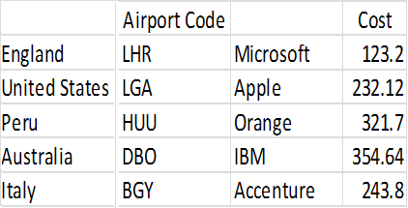
RUBIX - Experiments
Different languages (header name and cell values)
Abbreviations
Codes (IATA, NASDAQ)
Empty column headers
Notes:
Workflow

Slide 9
RUBIX - Experiments
SAP Travel Data (Event Tracker, Travel Expense Manager)
The data used in our evaluation consisted of around 60 columns and more than 1000 rows
AMC’s default configuration provided 12 matches with an accuracy of 83%
Our enhancements produced 10 matches that are 100% accurate
Overall similarity enhancement of 11%
Notes:
Workflow

Slide 10
RUBIX - Publications
Ahmad Assaf, Eldad Louw, Aline Senart, Corentin Follenfant, Raphael Troncy, David Trastour, RUBIX: A Framework for Improving Data Integration with Linked Data, to be published in ICP Series of the ACM Digital Library.
Ahmad Assaf, Eldad Louw, Aline Senart, Corentin Follenfant, Raphael Troncy, David Trastour, Improving Schema Matching with Linked Data, In Proceedings of the 1st International Workshop on Open Data (WOD), Nantes, France, May 2012.
Submission of one IDF

Slide 11
RUBIX – Experiments and Demo
Demo
DEMO

Slide 12
Research Direction
Mining
External Catalogue
Integration
Refining
Exploration
Matching
Analysis
Mapping
Data Quality Framework
RUBIX V1
DCAT Crawler
RUBIX V2
Yìngshè (Graph Mapper)
Notes:
Public data sets containing billions of data items
Companies are looking to integrate external data with their traditional enterprise data to improve business intelligence analysis

Slide 13

Yìngshè (Graph Mapper) – Demo
Demo
DEMO

Slide 14
Research Direction
Mining
External Catalogue
Integration
Refining
Exploration
Matching
Analysis
Mapping
Data Quality Framework
RUBIX V1
DCAT Crawler
RUBIX V2
Yìngshè (Graph Mapper)
Notes:
Public data sets containing billions of data items
Companies are looking to integrate external data with their traditional enterprise data to improve business intelligence analysis

Slide 15
Data Quality Framework
Data quality involves data management, modeling, analysis, storage and presentation
It is an important issue for data driven applications which should be deeply investigated and understood in order to ensure the data is fit to be combined and used to infer better business decisions
Data quality is subjective and cannot be assessed easily, the actual value of data is mainly realized when it is used
Studies found out that most data quality problems are in fact “data misinterpretations” or problems with the data semantics
→ With the rise of Semantic Web, new data quality principles should be identified
Notes:
So, how to properly integrate external data with internal ones? A certain level of quality is clearly necessary. Data Quality involves data management, modeling, analysis storage and presentation since it ensures that the data is fit to be combined and used to infer better business decisions. Quality is important in every data driven application; but it is a subjective measure, as the saying goes “beauty is in the eye of the beholder”. Quality is mainly realized when the data is used, it can be defined as fit for purpose of use !! But data can have multiple uses, and we want a generic framework to assess its quality.
Several studies have found out that most data quality problems are in fact “data misinterpretations” or problems in the data semantics, for example if I am querying for a revenue per year value, different sources might have different presentations for the term “year”, it can be a fiscal or calendar year or even the last 12 months.
By now we identified that there is a need for new Data quality principles in terms of measures and classes.

Slide 16
Our Proposal
Data Quality Principle | Attribute
Quality of Data Sources | Accessibility
 | Authority & Sustainability
 | License
 | Trustworthiness & verifiability
 | Performance
Quality of raw data | Accuracy | Referential correspondence
 |  | Cleanness
 |  | Consistency
 | Comprehensibility
 | Completeness
 | Typing
 | Provenance
 | Versatility
 | Traceability
Quality of the semantic conversion | Correctness
 | Granularity
 | Consistency
Quality of the linking process | Connectedness
 | Isomorphism
 | Directionality
Notes:
Building on the previous principles and based on our experience with powerful data integration software to extract, transform, and load data from applications, databases and other data sources, we have derived five principles for data quality in the Semantic Web
Quality of data source: This principle is related to the availability of the data and the credibility of the data source.
Quality of raw data: This principle is mainly related to the absence of duplicates, entry mistakes, and noise in the data.
Quality of the semantic conversion: This principle is related to the transformation of raw data into rich data by using vocabularies.
Quality of the linking process: This principle is related to the quality of links between two datasets.
Global quality: This principle is cross-cutting the other principles and covers the source, raw data, semantic conversion, reasoning and links quality.

Slide 17
Data Quality - Publications
Ahmad Assaf and Aline Senart, Data Quality Principles in the Semantic Web, In Proceedings of the International Workshop on Data Quality Management and Semantic Technologies (DQMST 2012), September 2012, Palermo, Italy
Submission of one IDF

Slide 18
Research Direction
Mining
External Catalogue
Integration
Refining
Exploration
Matching
Analysis
Mapping
Data Quality Framework
RUBIX V1
DCAT Crawler
RUBIX V2
Yìngshè (Graph Mapper)
Notes:
Public data sets containing billions of data items
Companies are looking to integrate external data with their traditional enterprise data to improve business intelligence analysis

Slide 19
DCAT Crawler
RDF vocabulary to describe datasets in data catalogs
It aims to:
Facilitate interoperability between data catalogs published on the Web
Increase discoverability
Enable applications easily to consume metadata from multiple catalogs
Facilitates federated dataset search
Automatically generate DCAT descriptions for external and Internal data sources
Investigate the Introduction quality metrics in the DCAT specification
Notes:
Public data sets containing billions of data items
Companies are looking to integrate external data with their traditional enterprise data to improve business intelligence analysis

Slide 20
Thank You!
Contact information:
Ahmad Assaf
www.ahmadassaf.com
@ahmadaassaf
SAP Research, France
Ahmad.assaf@sap.com
+33 695 436 614

